Slide 1
Week 5: Final Project
Robert D. Wescott
The University of Arizona Global Campus
CST 499: Capstone for Computer Software Technology
Instructor: Dr. Amr Elchouemi
July 18, 2022

Slide 2
SRS Document Summary: Highlighting the key aspects of the software requirements specification

Slide 3
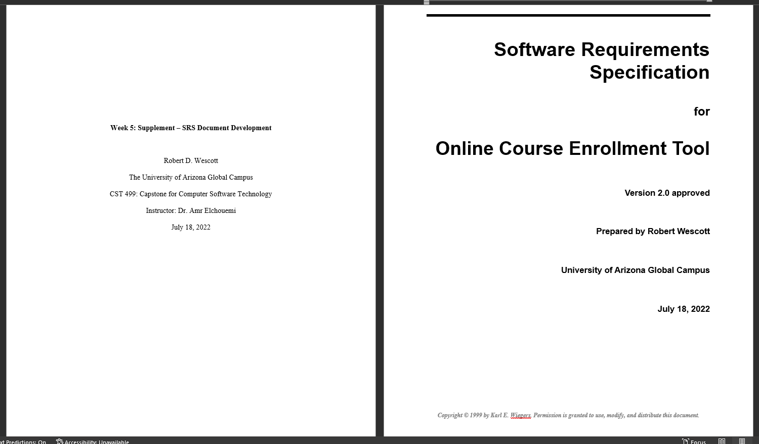
SRS Document Highlights

Slide 4
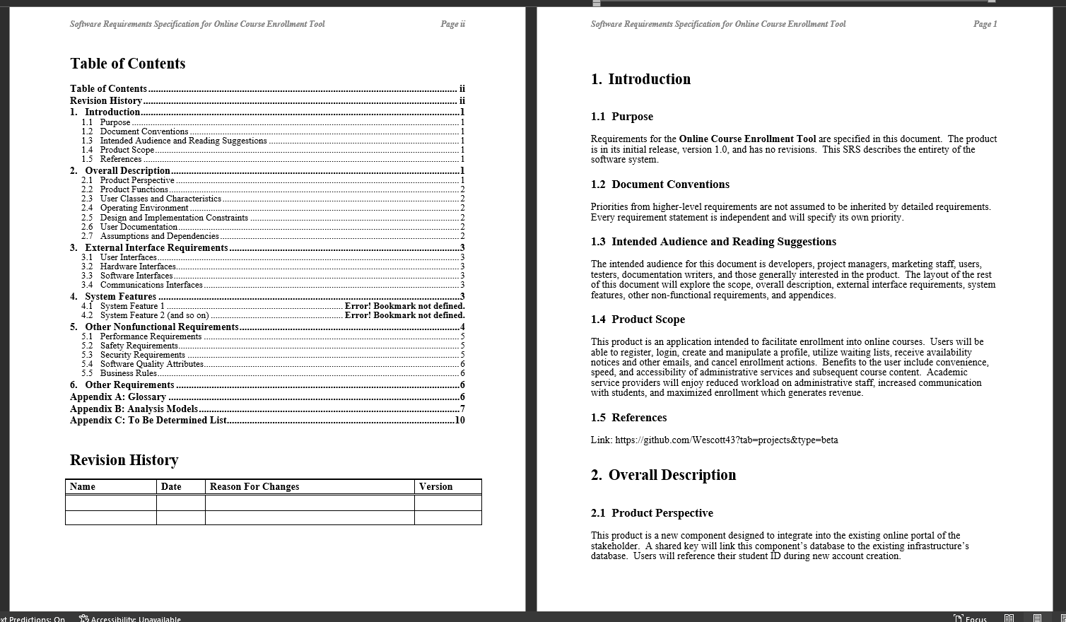
SRS Document Highlights

Slide 5
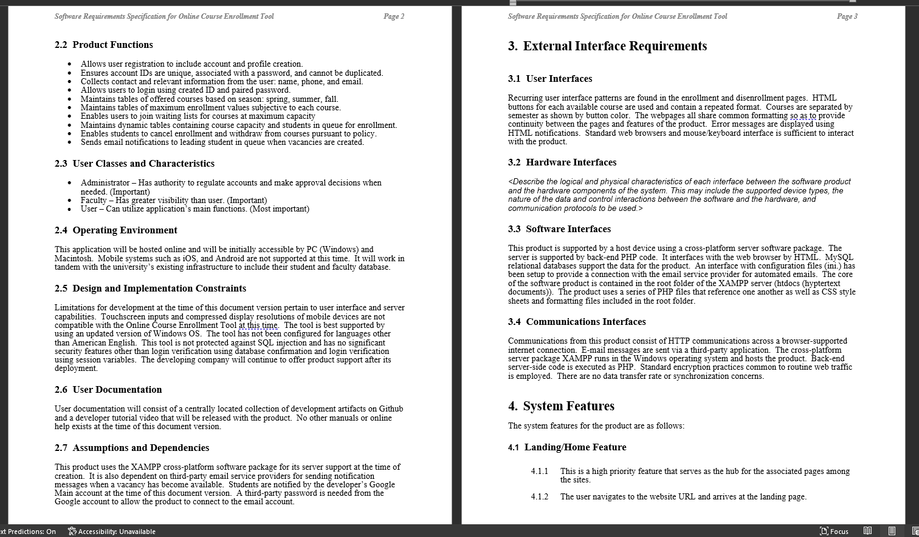
SRS Document Highlights

Slide 6
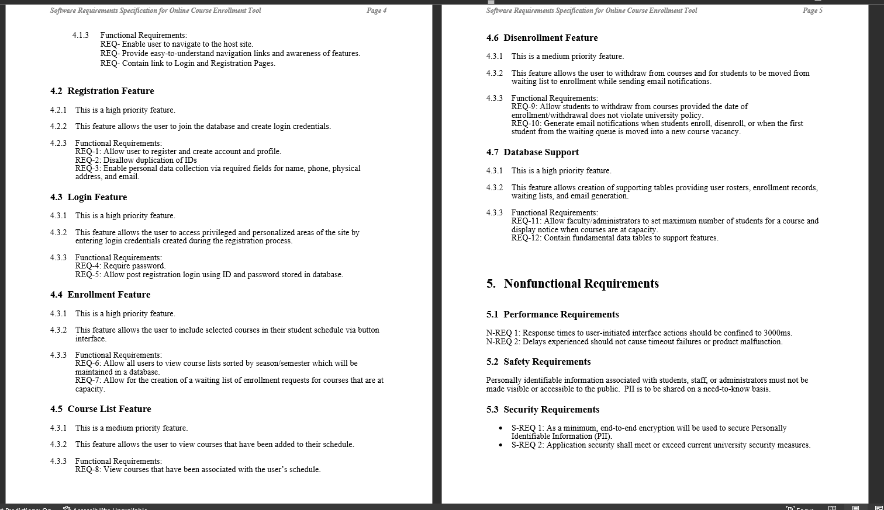
SRS Document Highlights

Slide 7
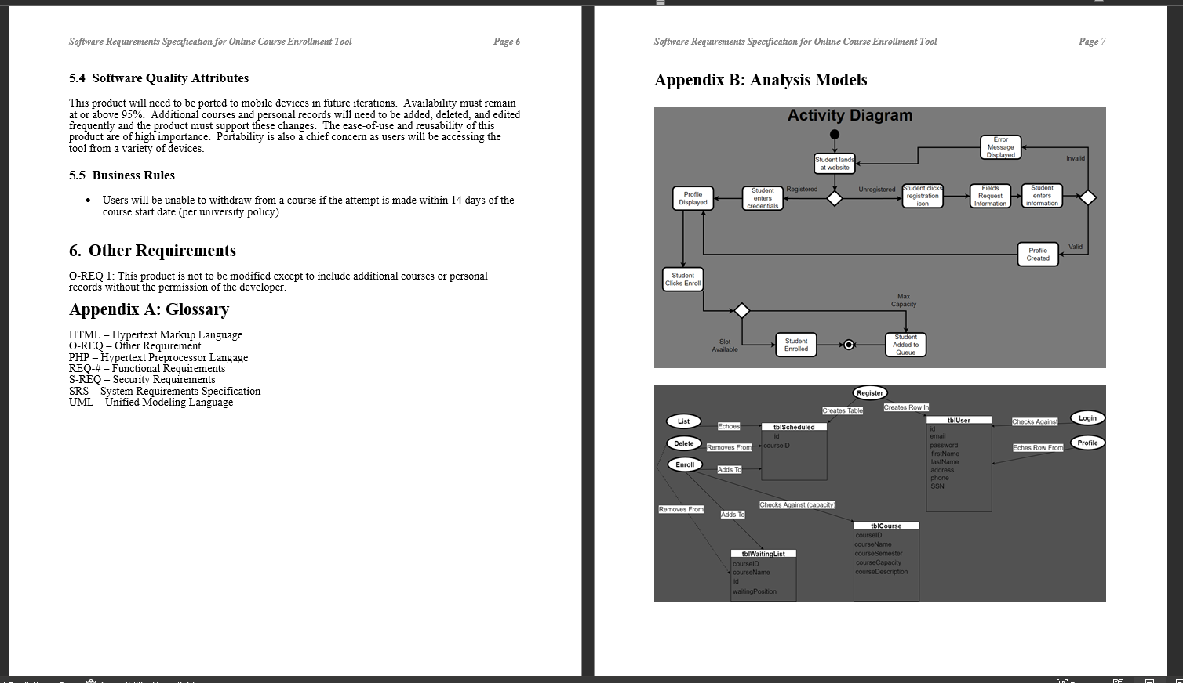
SRS Document Highlights

Slide 8
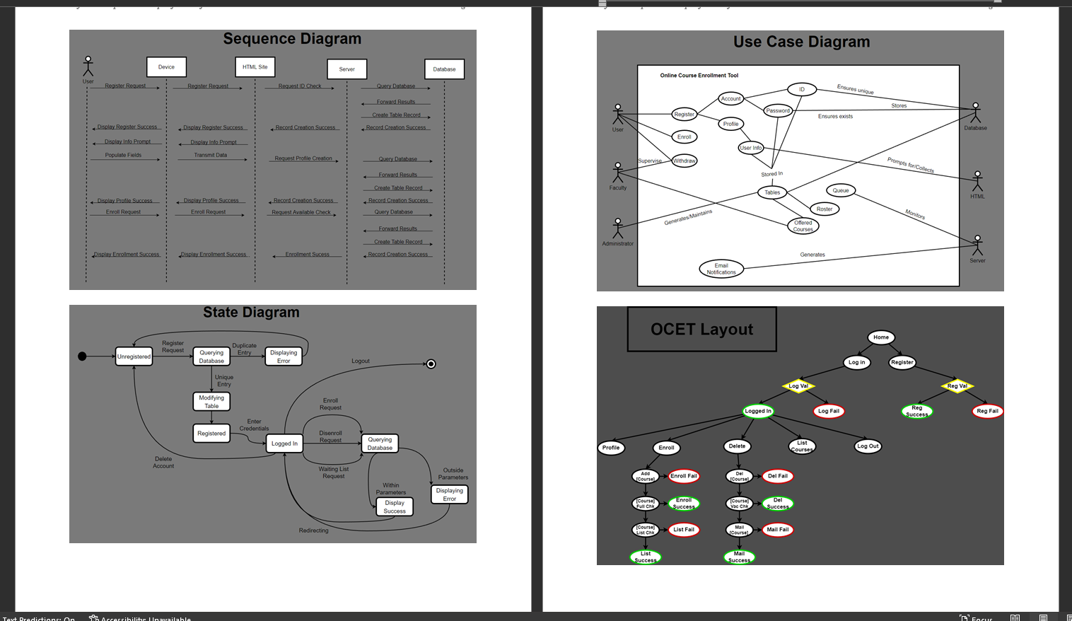
SRS Document Highlights

Slide 9
UML Design Model: Showcasing the artifacts in Unified Modeling Language.

Slide 10
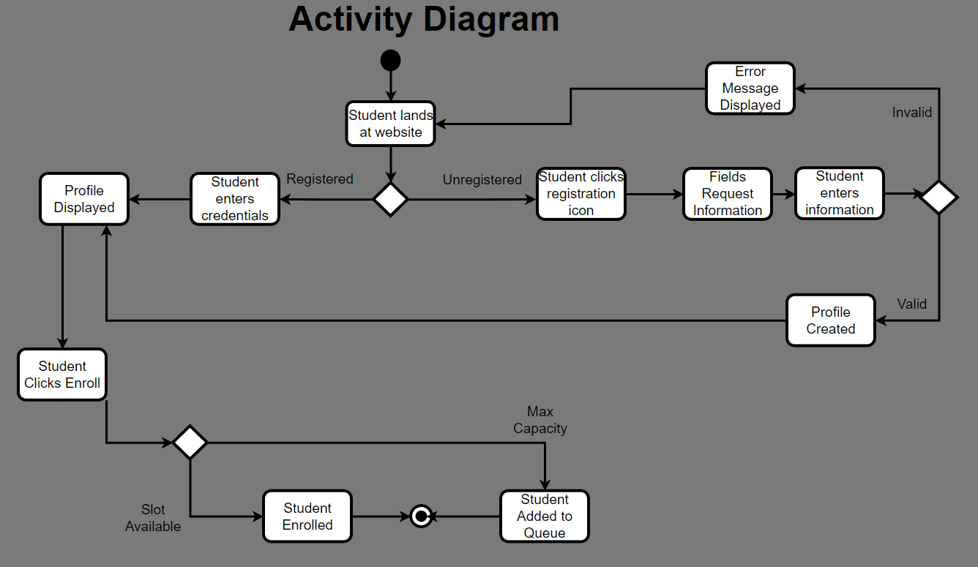
UML Model Showcase

Slide 11
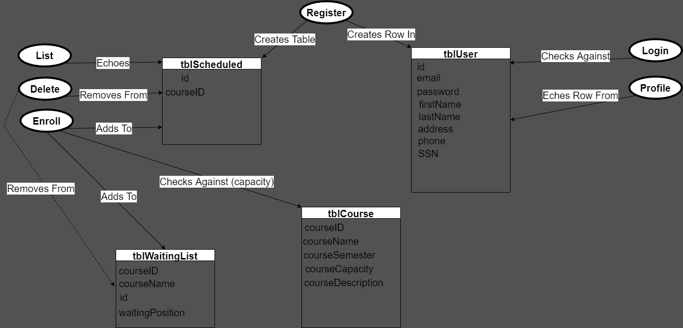
UML Model Showcase

Slide 12
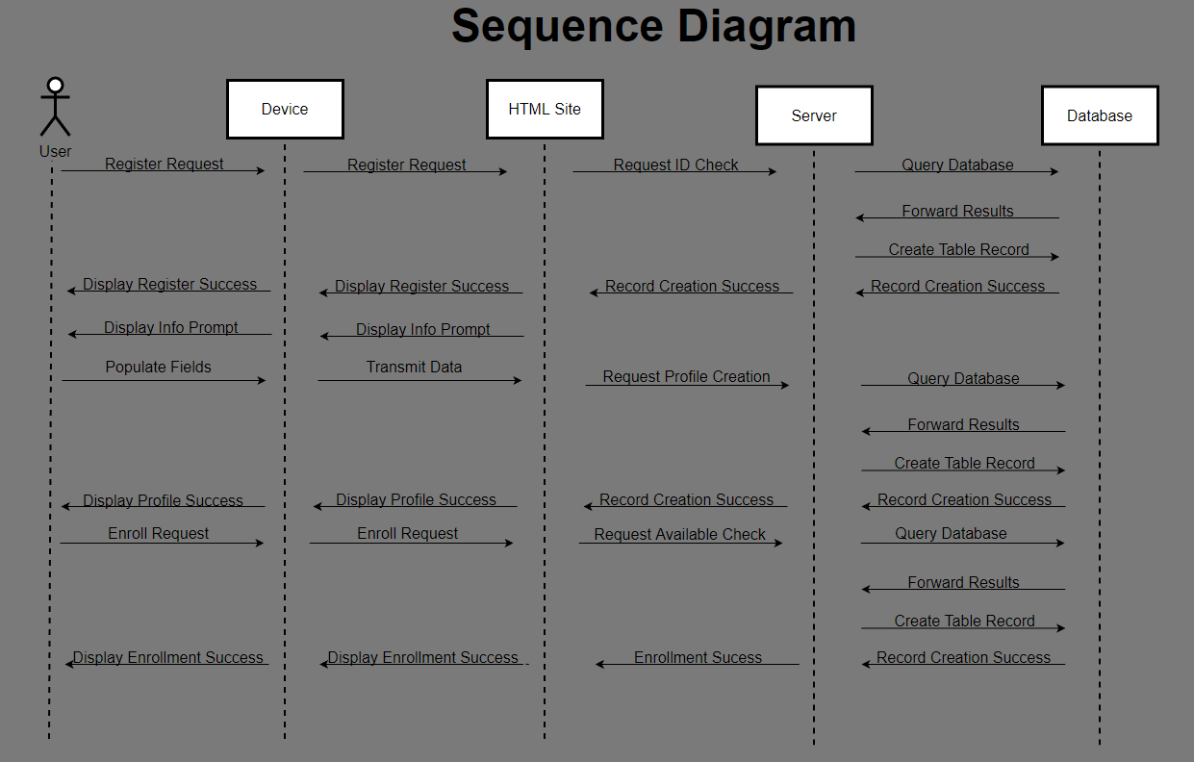
UML Model Showcase

Slide 13
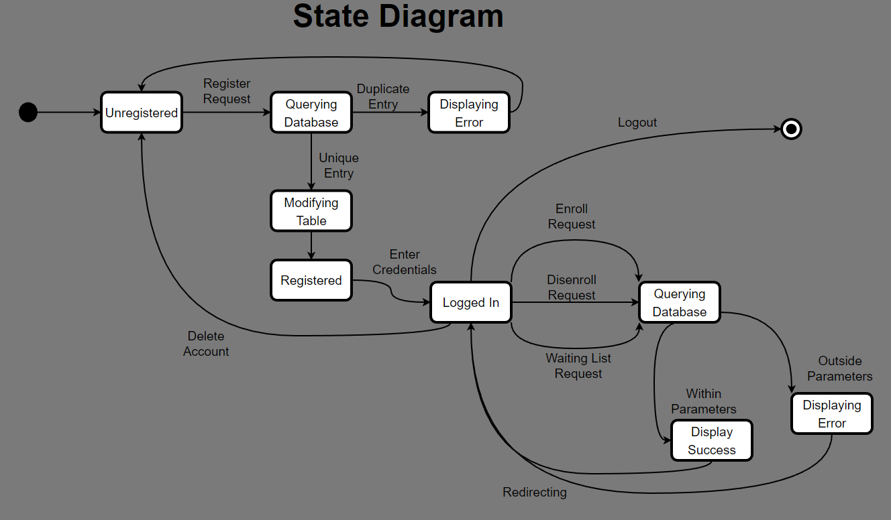
UML Model Showcase

Slide 14
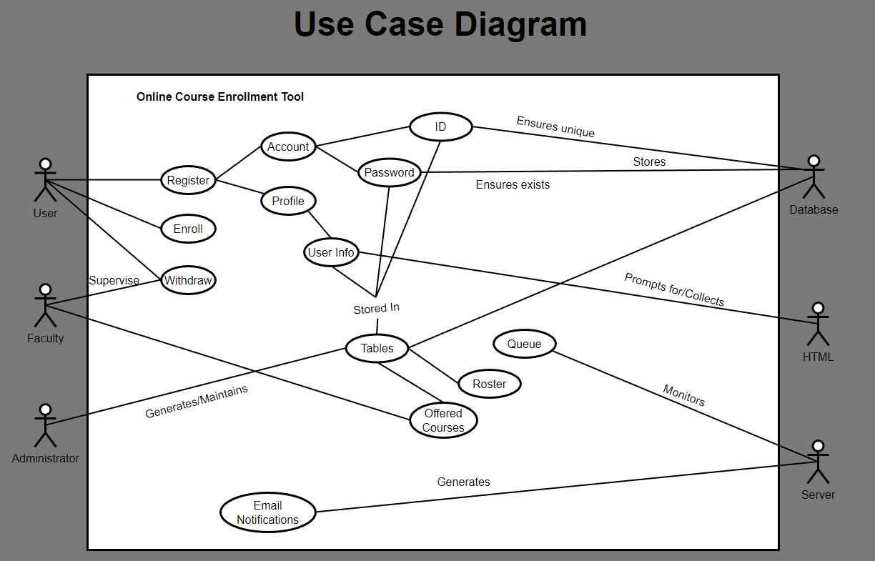
UML Model Showcase

Slide 15
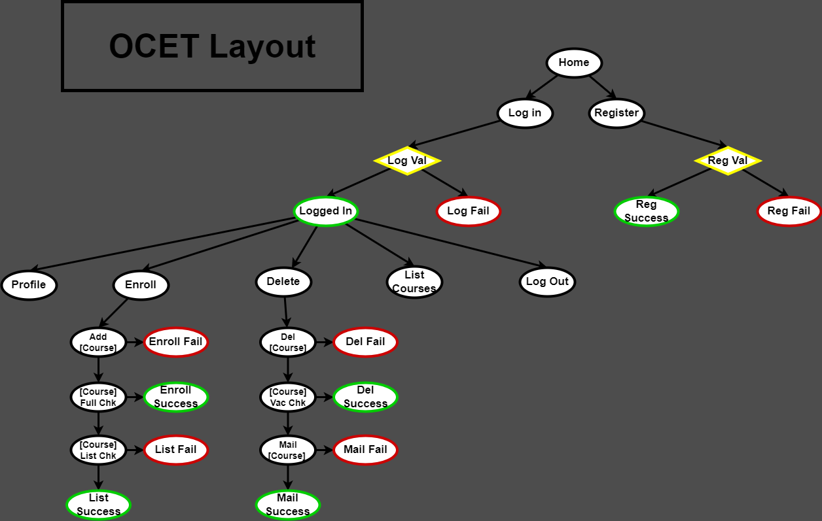
UML Model Showcase

Slide 16
Landing, Login, & Enrollment: An explanation of page design.

Slide 17
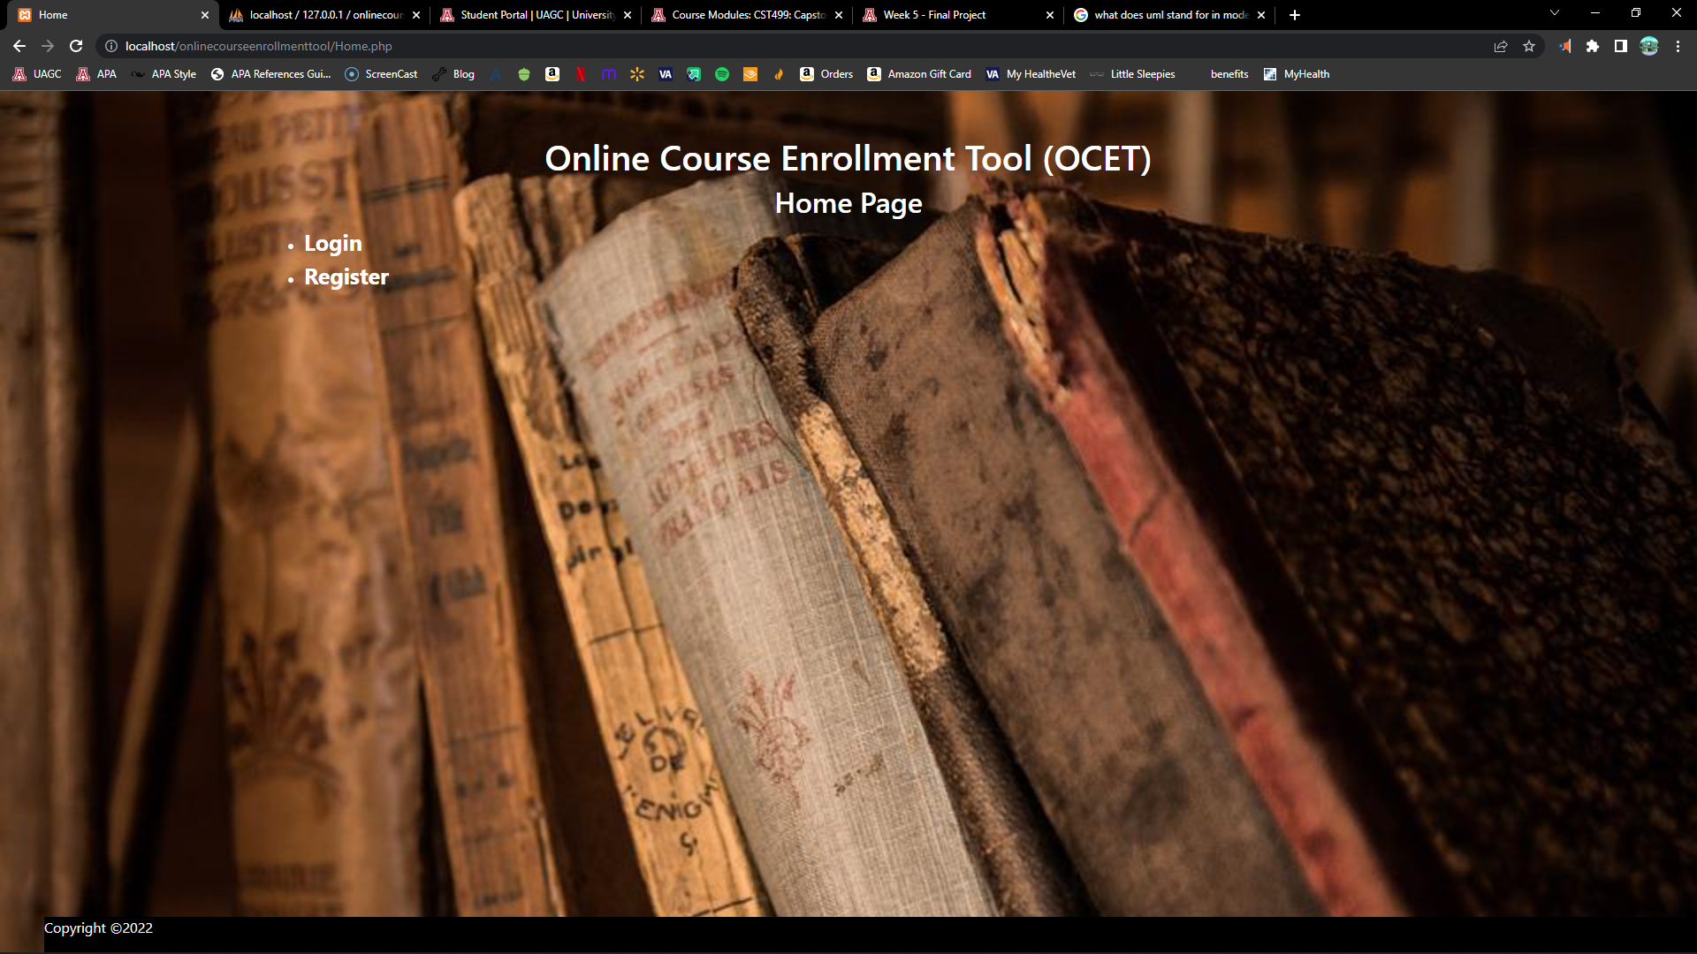
Landing Page

Slide 18
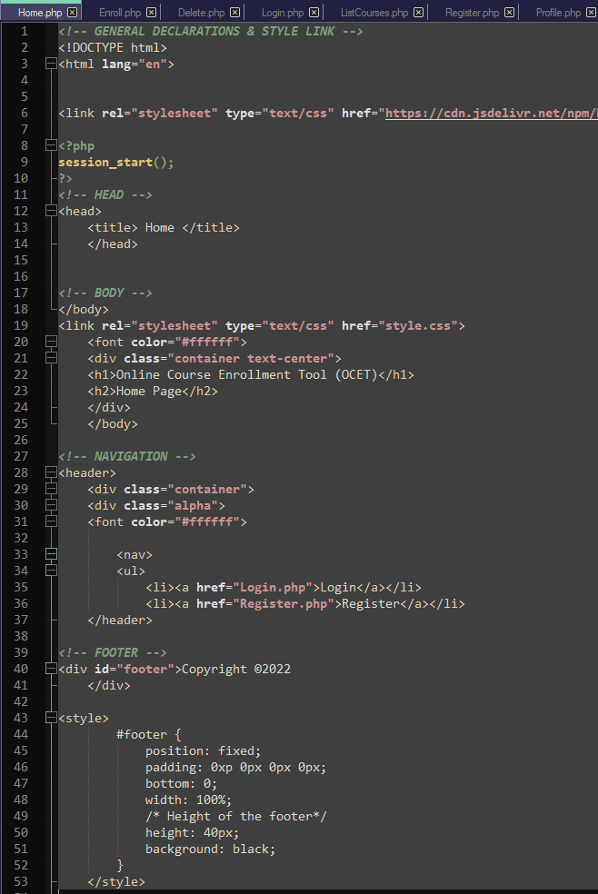
Landing Page

Slide 19
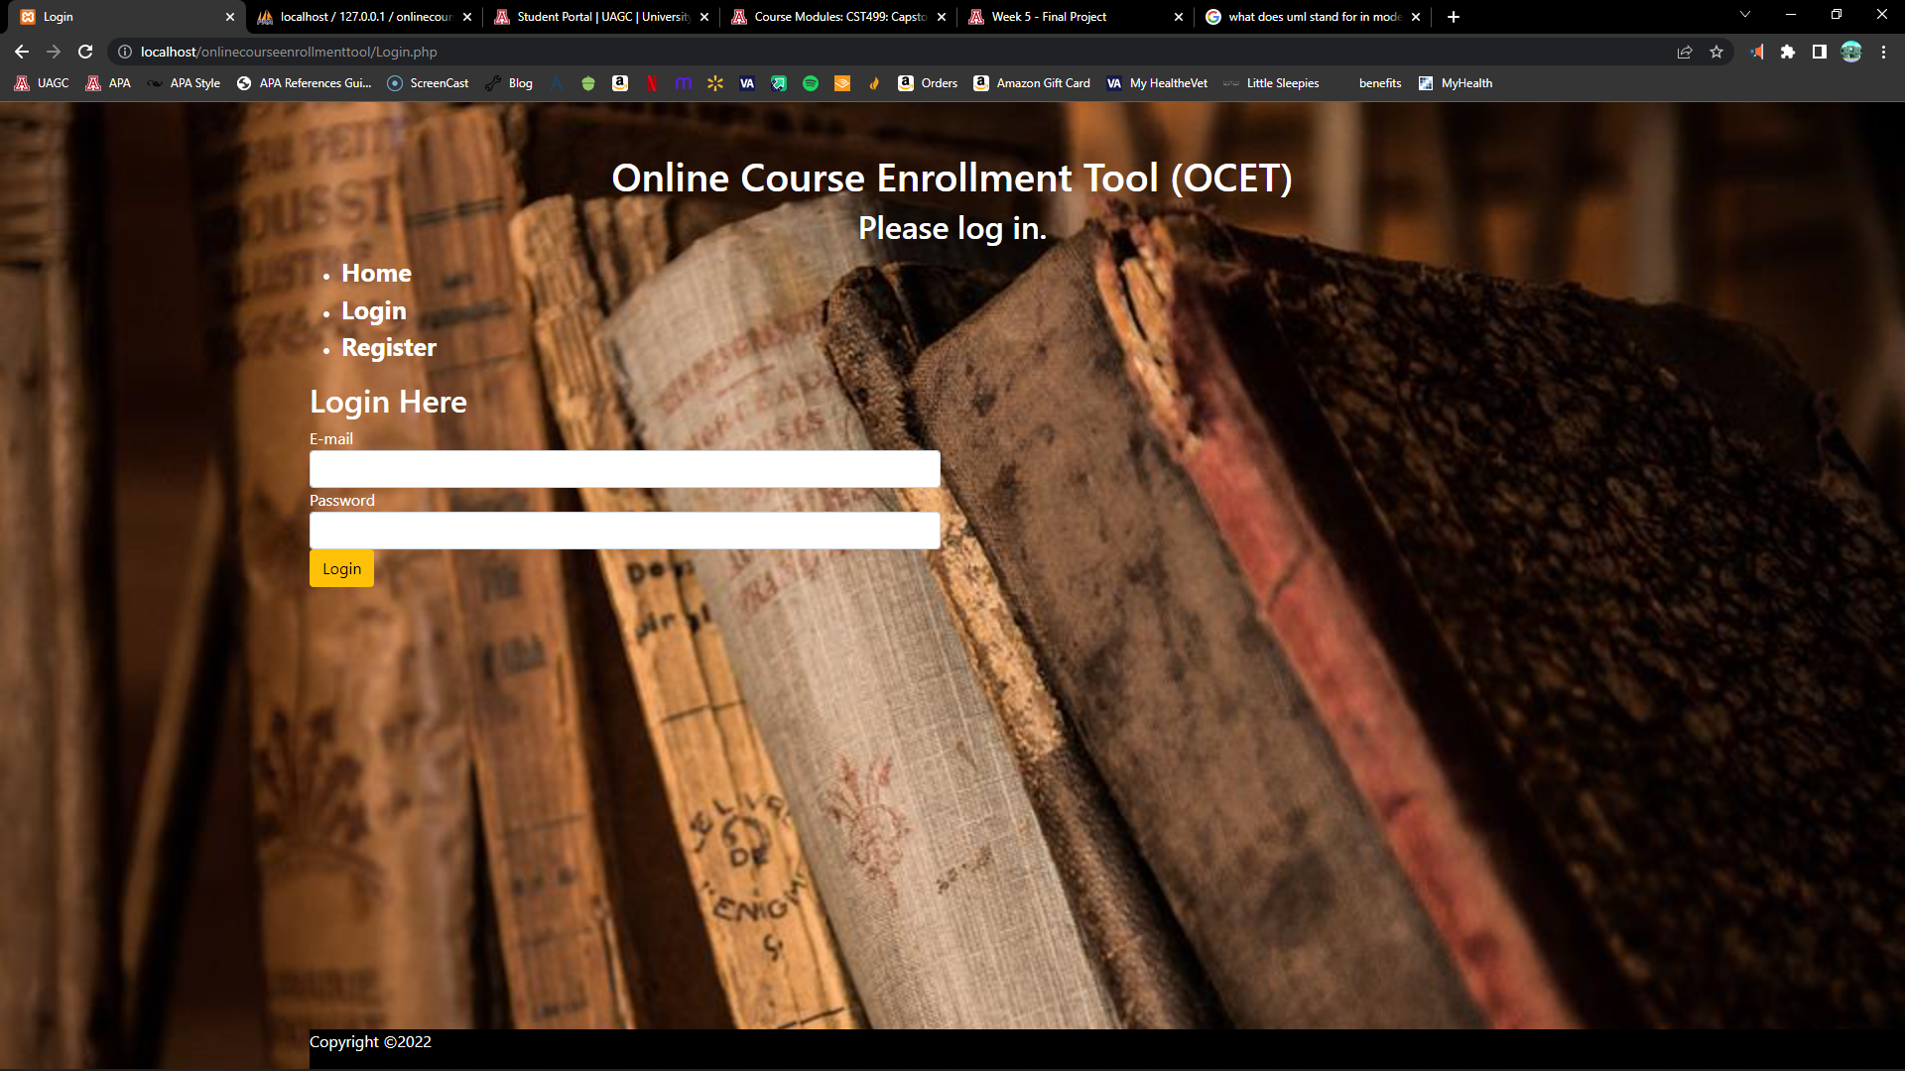
Log In Page

Slide 20
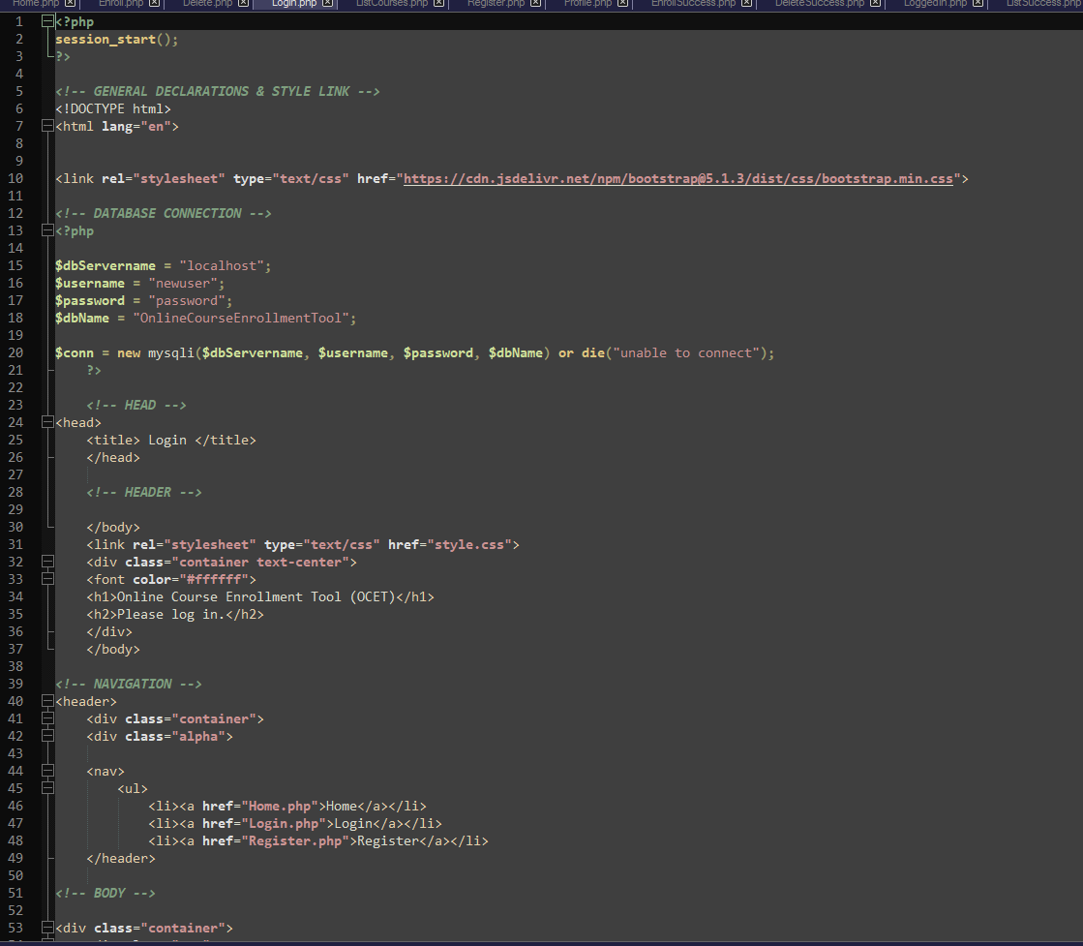
Log In Page

Slide 21
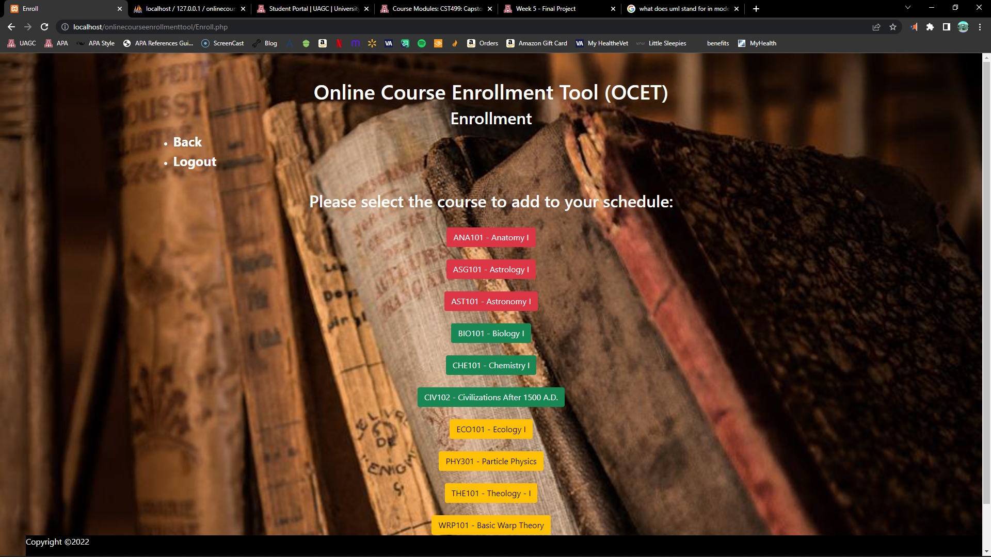
Enrollment Page

Slide 22
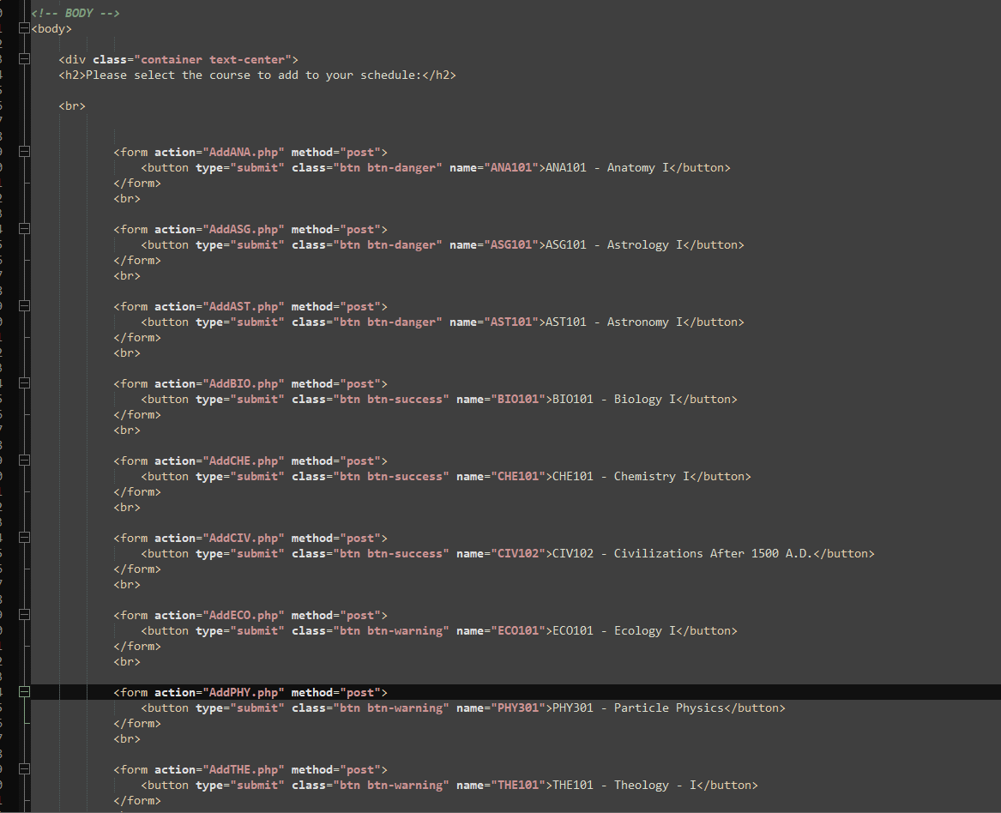
Enrollment Page

Slide 23
MySQL Database: Exploring the objects.

Slide 24
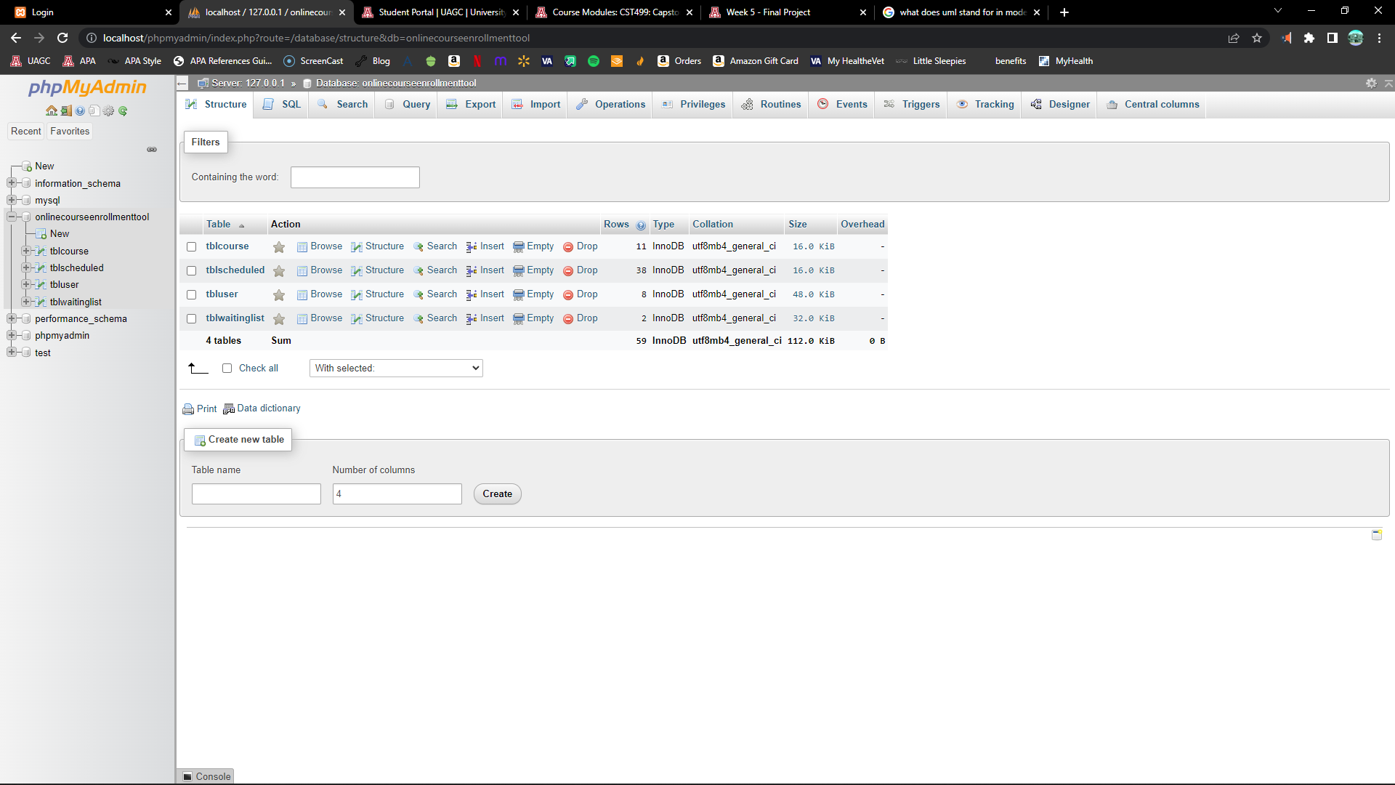
MySQL Database (all tables)

Slide 25
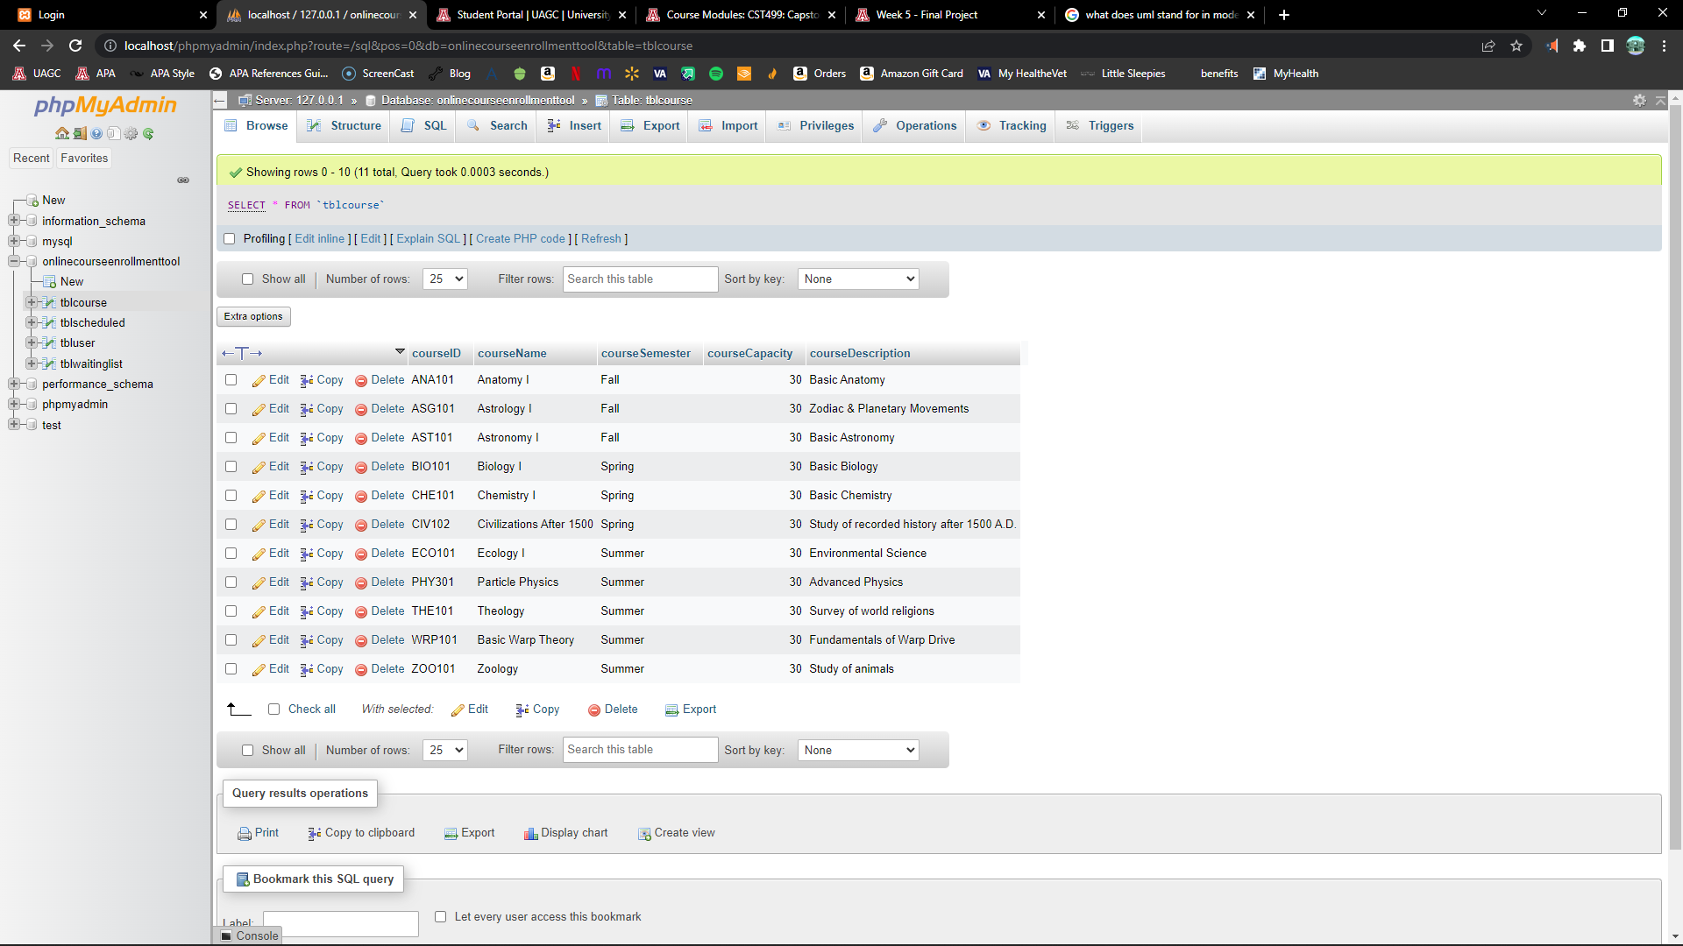
MySQL Database (course table)

Slide 26
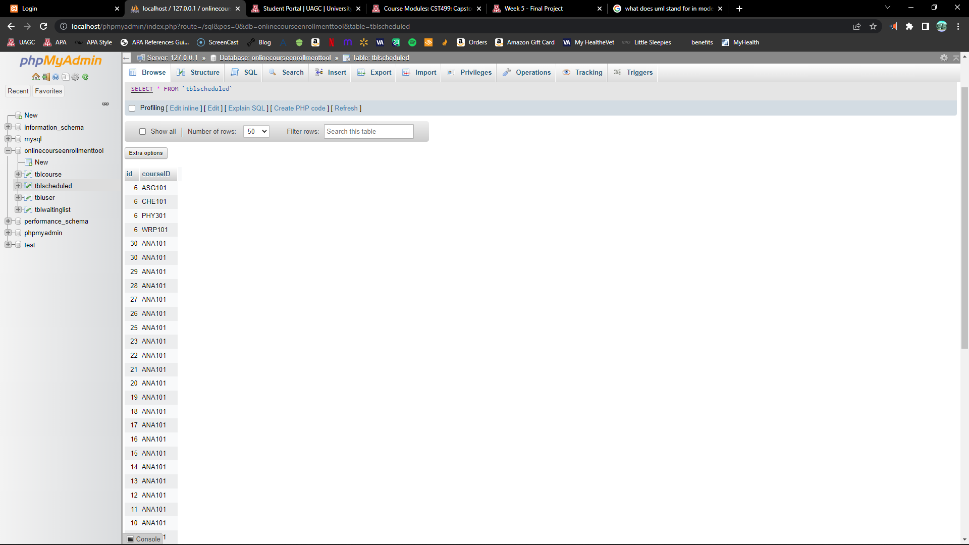
MySQL Database (table sched.)

Slide 27
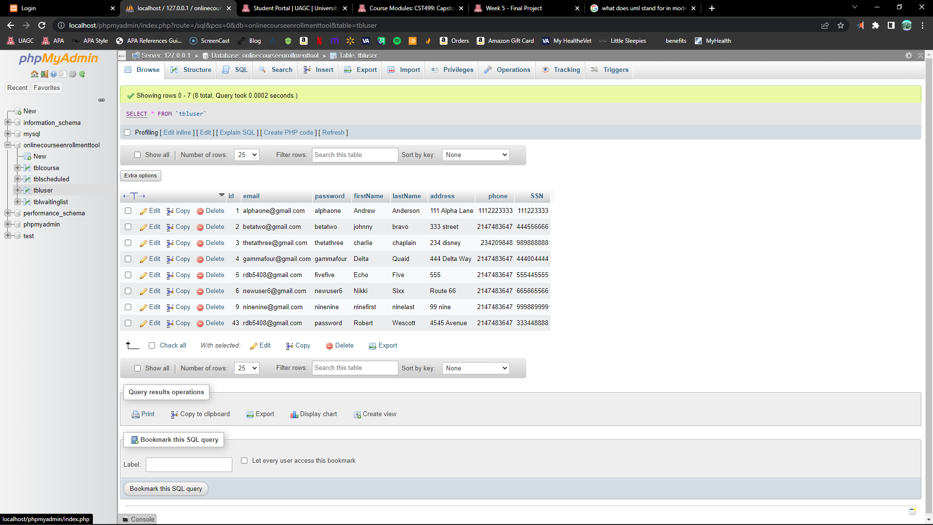
MySQL Database (table user)

Slide 28
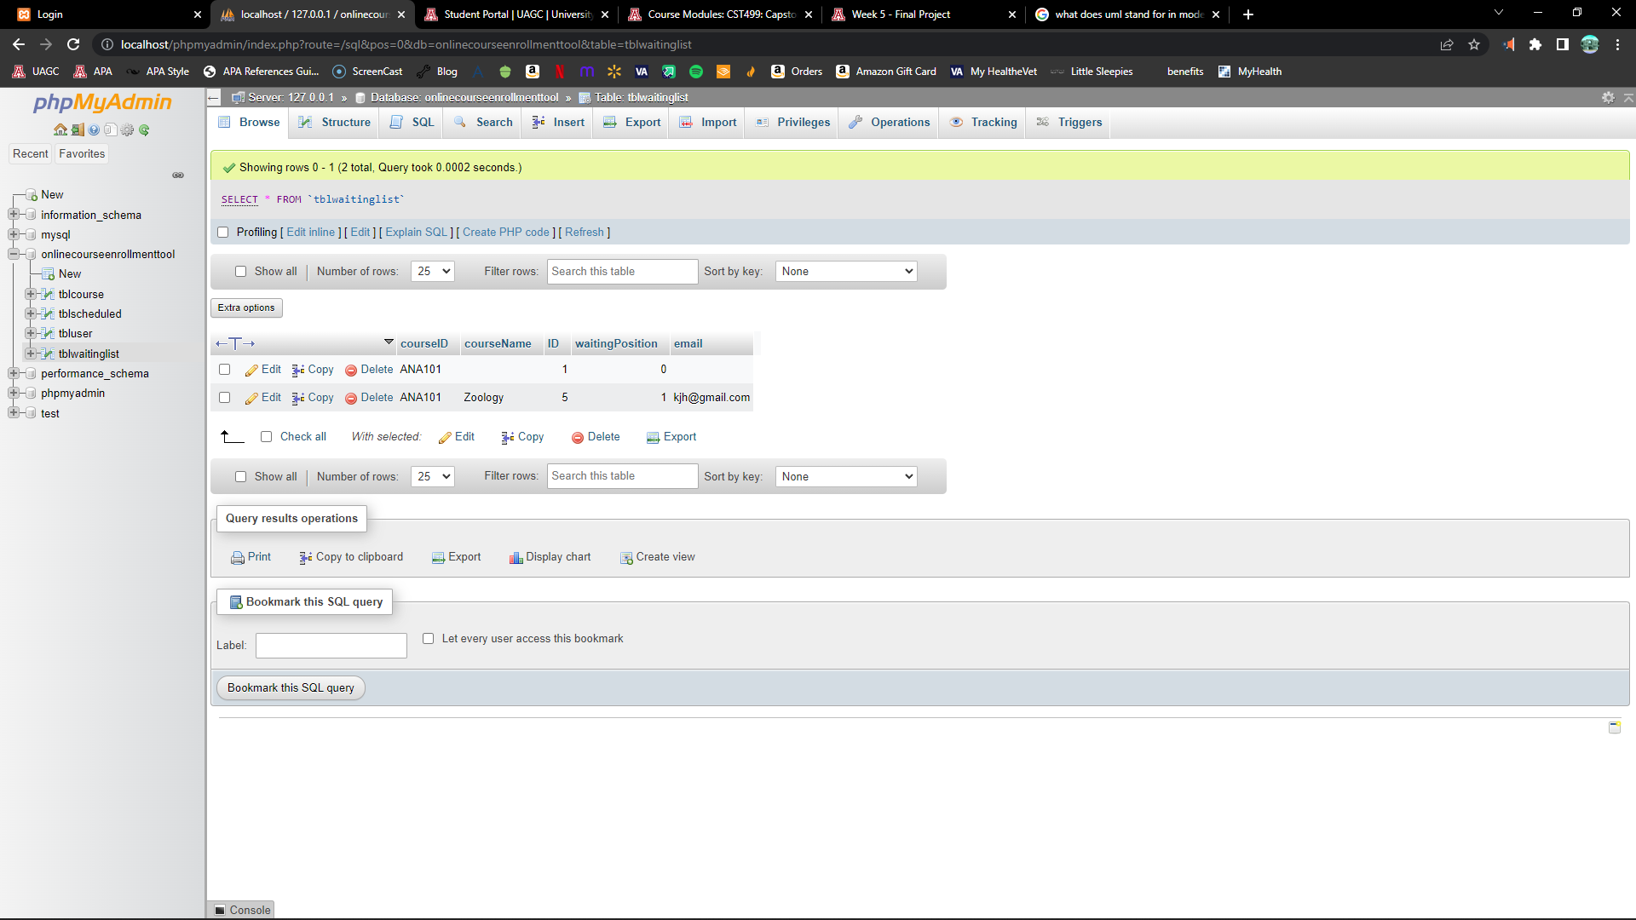
MySQL Database (table waiting list)

Slide 29
PHP Code: Hypertext Preprocessor code.

Slide 30
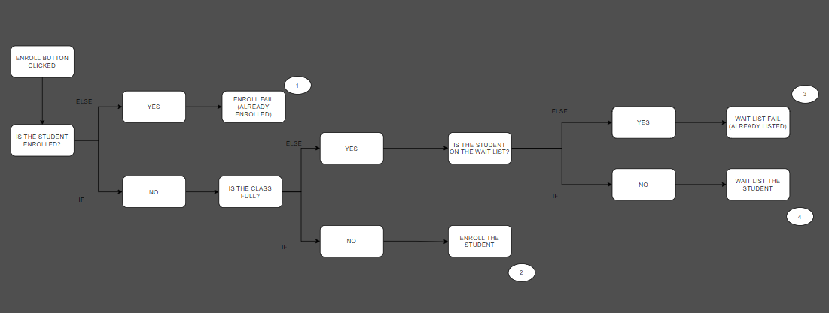
PHP Code (Complex Concept)

Slide 31
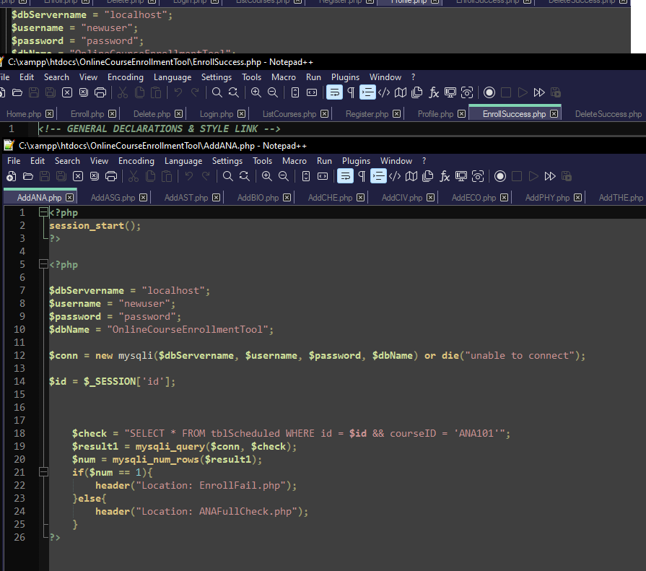
PHP Code (Add Course)

Slide 32
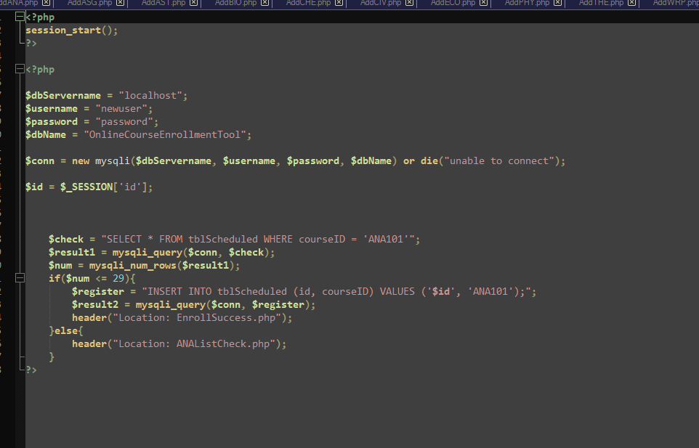
PHP Code (Full Check)

Slide 33
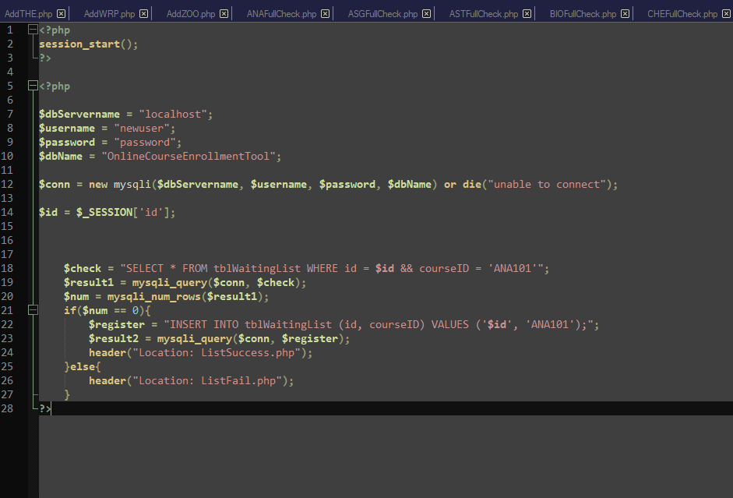
PHP Code (List Check)

Slide 34
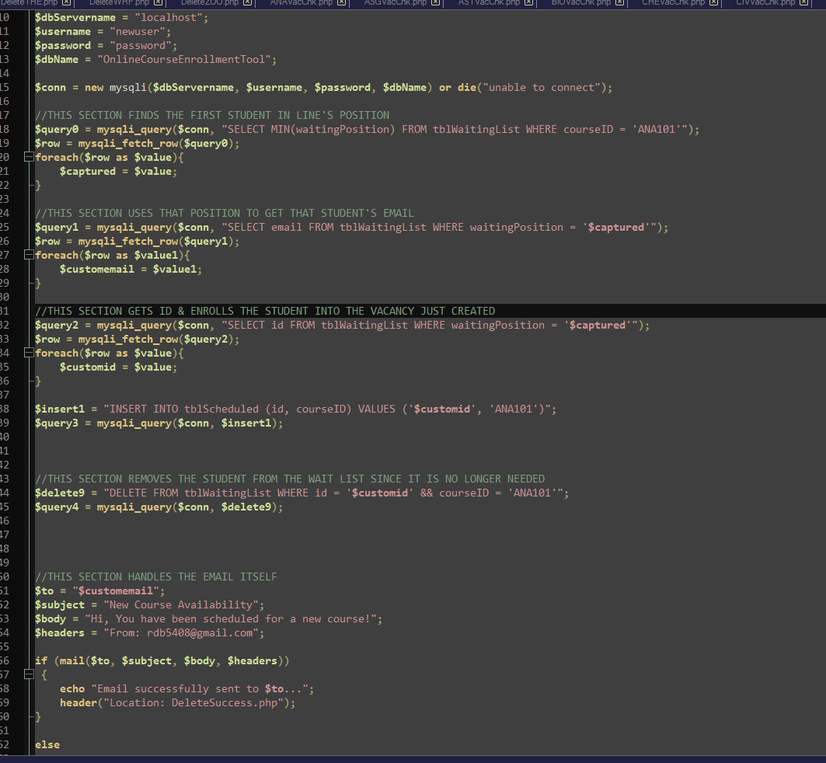
PHP Code (Mail)

Slide 35
PHP Code (DEMO)

Slide 36
Thank you!

Slide 37
References
Abraham, A. (2021, April 14). Team Roles in Software Development. Medium. https://medium.com/agileinsider/team-roles-in-software-development-3f87a58110d6
Dooley, J. F. (2017). Software development, design, and coding: With patterns, debugging, unit testing, and refactoring (2nd ed.). Retrieved from https://www.vitalsource.com/
GeeksforGeeks. (2021, September 1). Façade Design Pattern | Introduction. GeeksforGeeks. https://www.geeksforgeeks.org/facade-design-pattern-introduction/
Nesmiyanova, A. (2021). Effective Collaboration Is the Secret to Your Software Development Project Success. Steel kiwi. https://steelkiwi.com/blog/collaboration-is-a-key-to-project-success/
Mooney, A. (2021). How Much Does Custom Enterprise Software Cost? Soltech. https://soltech.net/enterprise-software-cost/
Pavlichenko, I. (2018, July 11). Eliminate Dependencies, Don’t Manage Them. Scrum.org. https://www.scrum.org/resources/blog/eliminate-dependencies-dont-manage-them
Smith, A. (2017, December 7). Usability First — Why Usability Design Matters to UI/UX Designers. UX Planet. https://uxplanet.org/usability-first-why-usability-design-matters-to-ui-ux-designers-9dfb5580116a
TutorialsPoint. (2021). Design Pattern – Factory Pattern. TutorialsPoint. https://www.tutorialspoint.com/design_pattern/factory_pattern.htm

